Slide 1

DnA Team Tech Talk
Speaker: Nguyen Thi Binh An

Slide 2
CONTENTS
Database Overview
Types of Databases
Dive into SQL

Slide 3
Database Overview

Slide 4

DATABASE DEFINITION
An organized collection of data .
Allows users to store, manage, retrieve, manipulate information efficiently.
ROLE OF DATABASE
Backbone of the application.
Data management.
Scalability, Security, Backup…

Slide 5
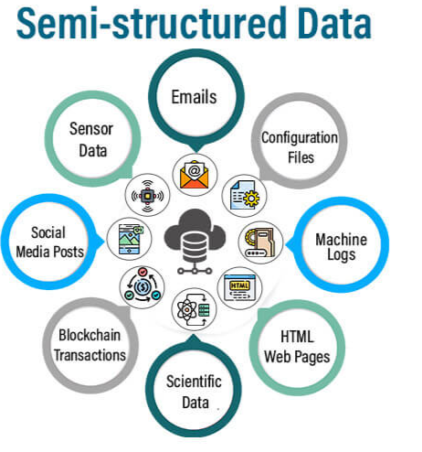
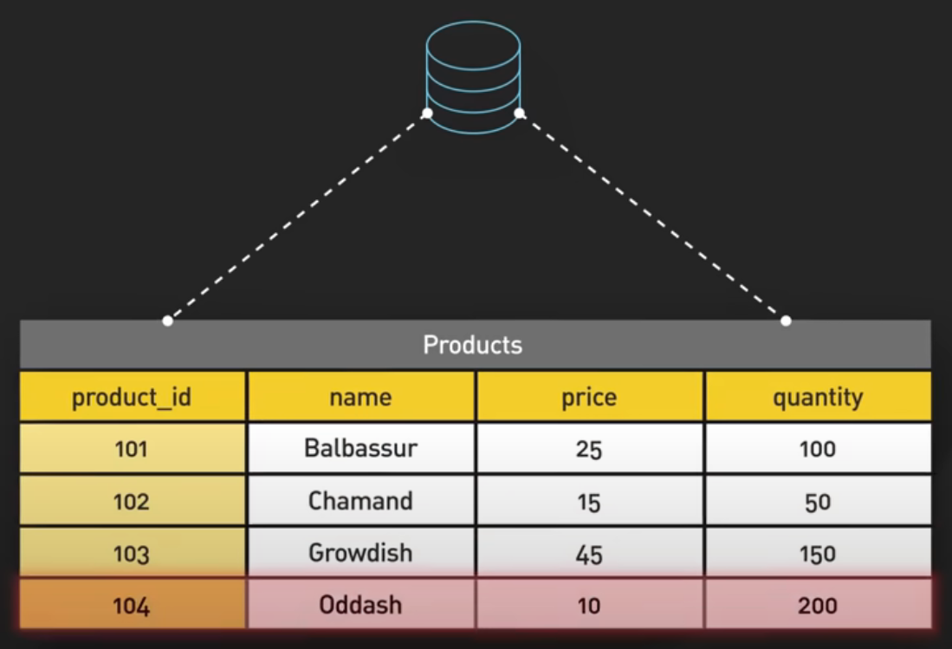


Structured
Un-structured

Slide 6
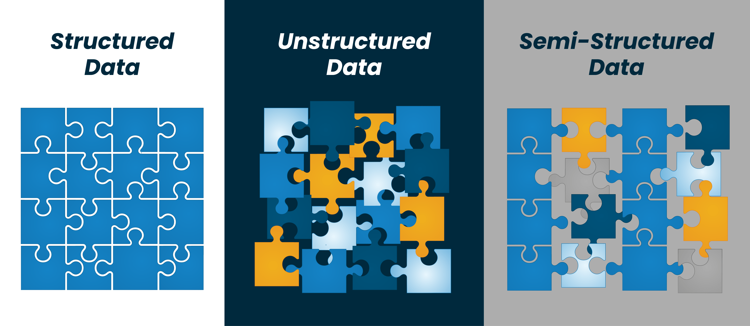

Slide 7
VOLUME
Amount or size of data that organization are dealing.
VELOCITY
Speed at which new data is generated, collected, processed
VARIETY
Different types, structures, and sources of data

Slide 8
Types of Databases

Slide 9
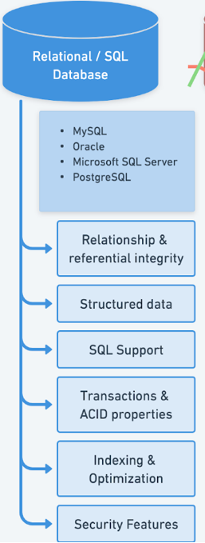
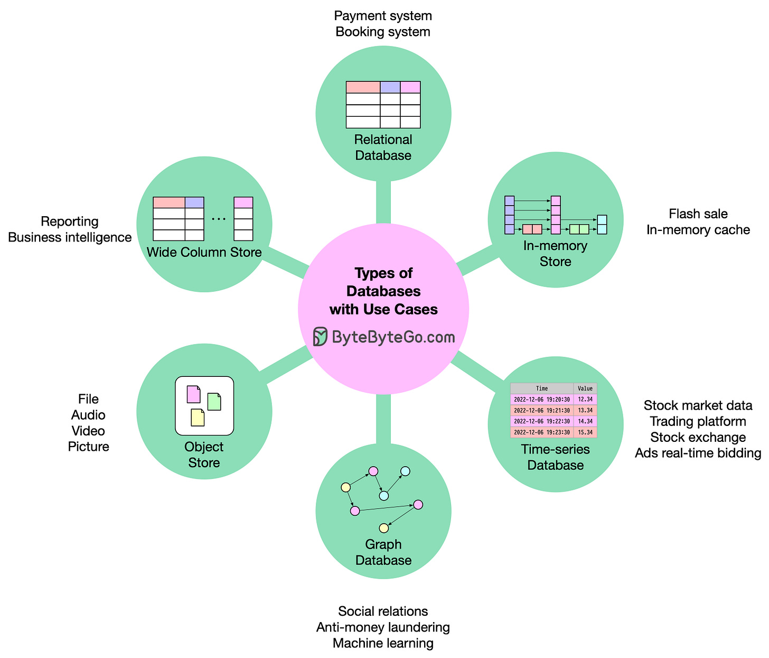

Slide 10
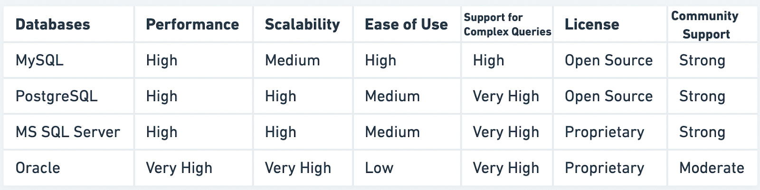

Slide 11
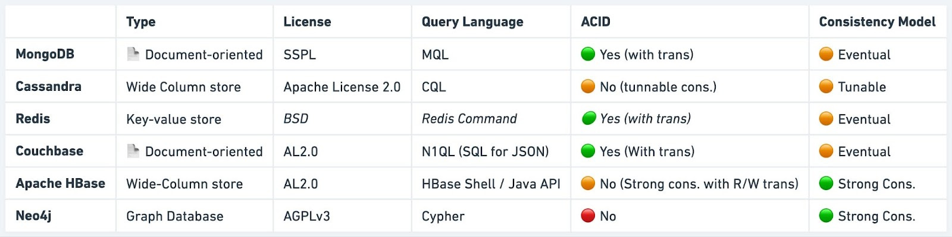

Slide 12
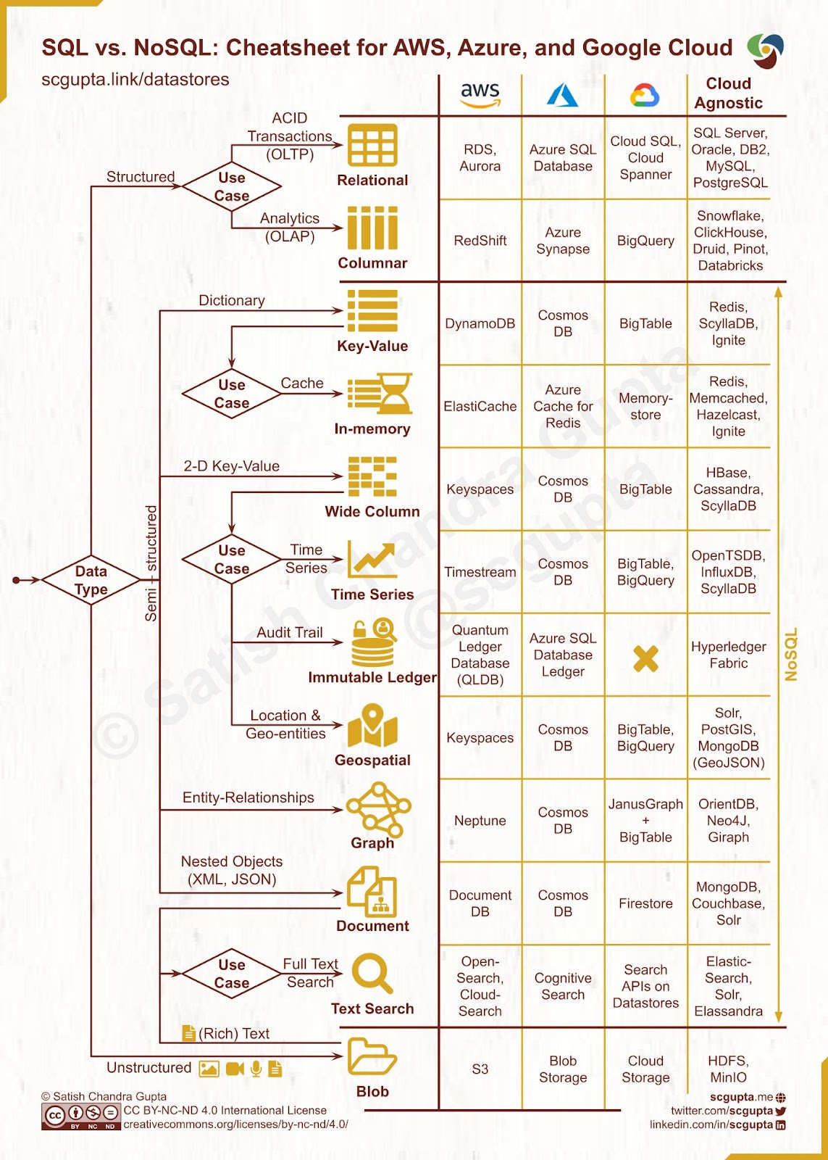

Slide 13
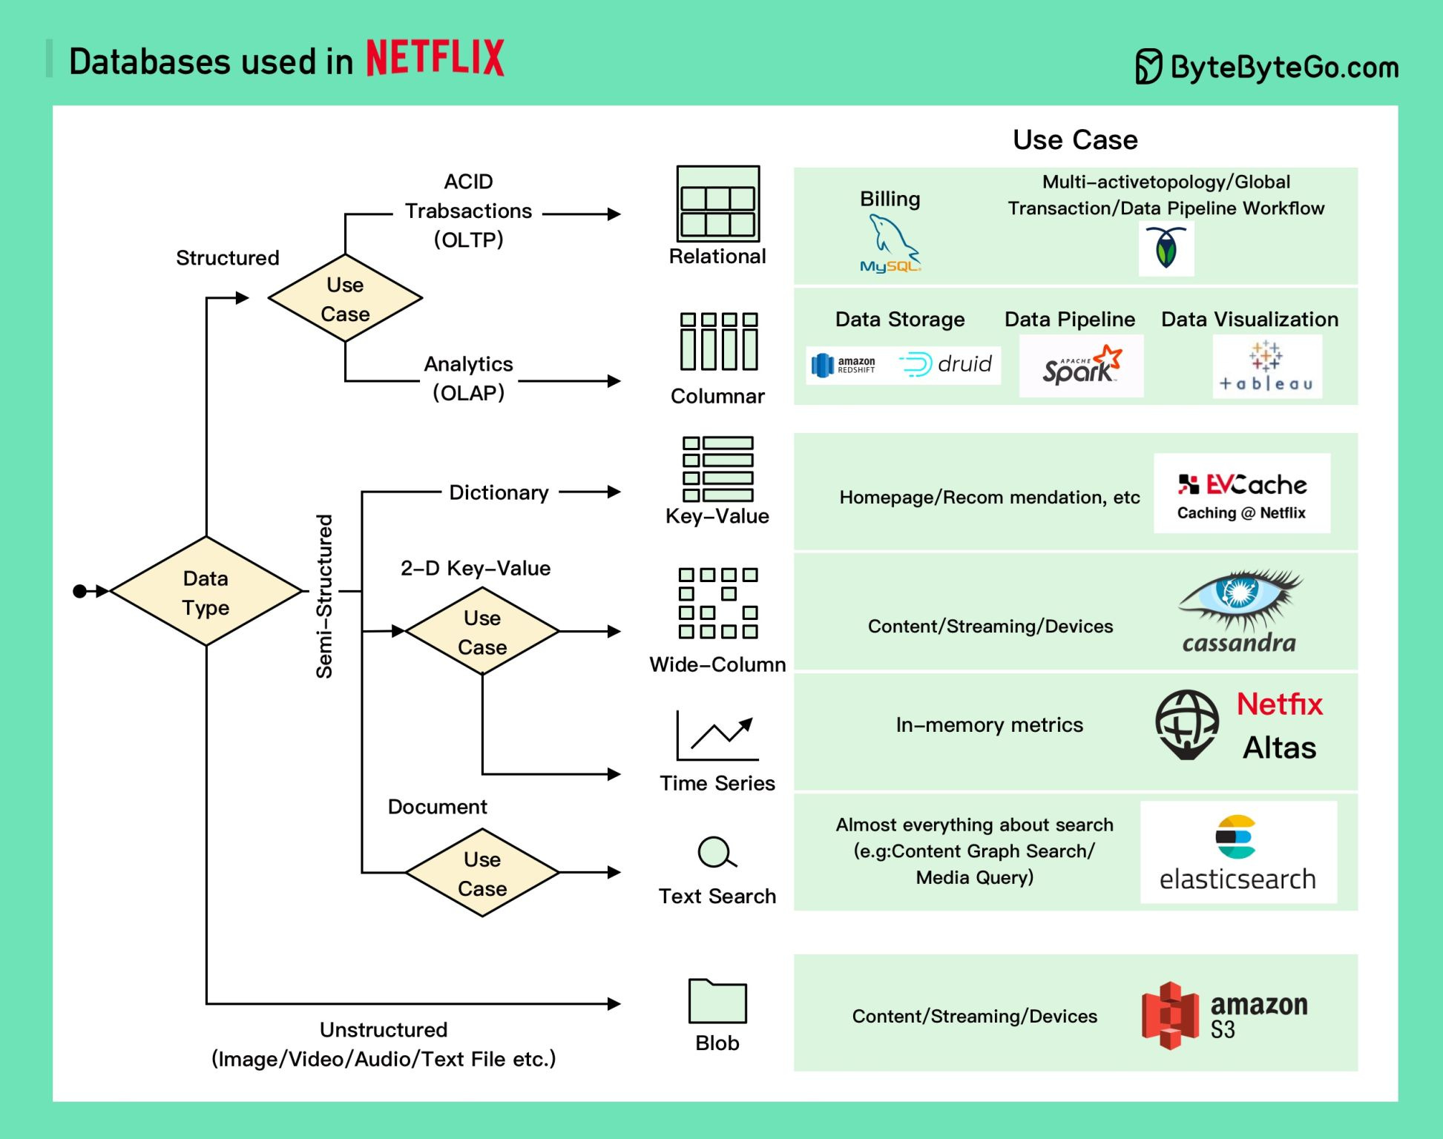

Slide 14
Dive into SQL

Slide 15
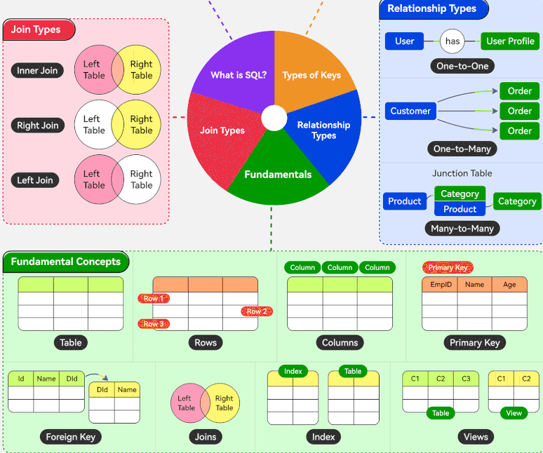

Slide 16
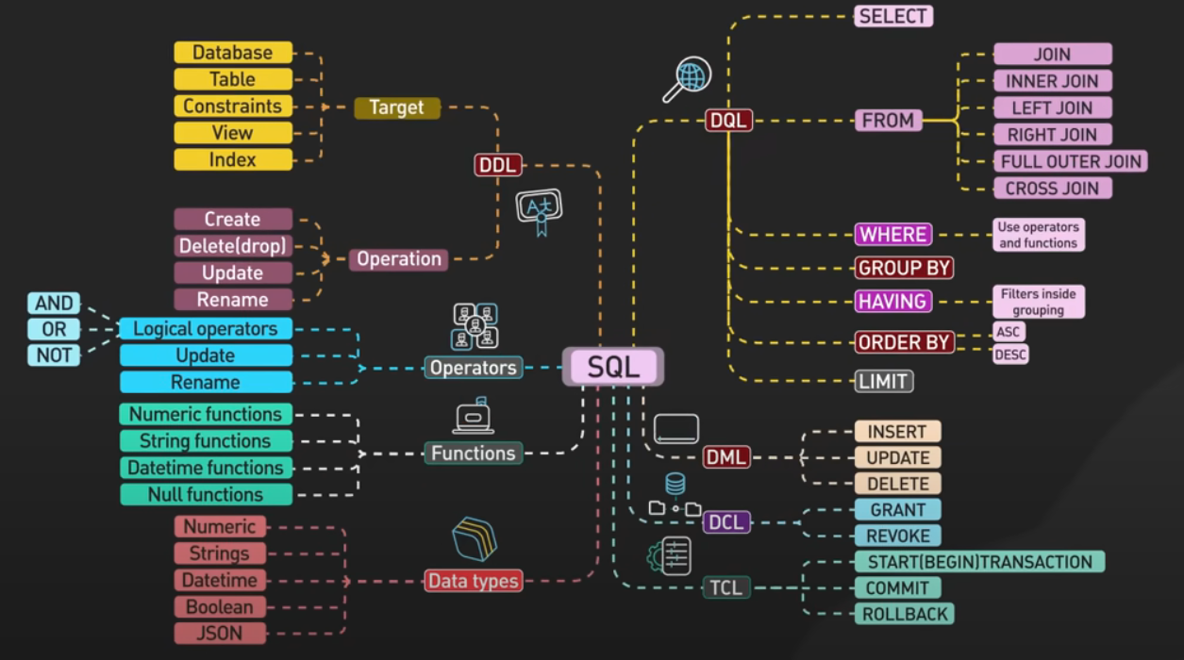

Slide 17
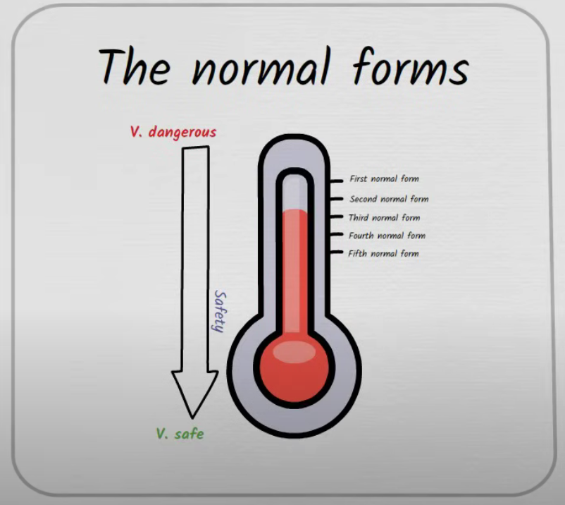
Database Normalization

Slide 18
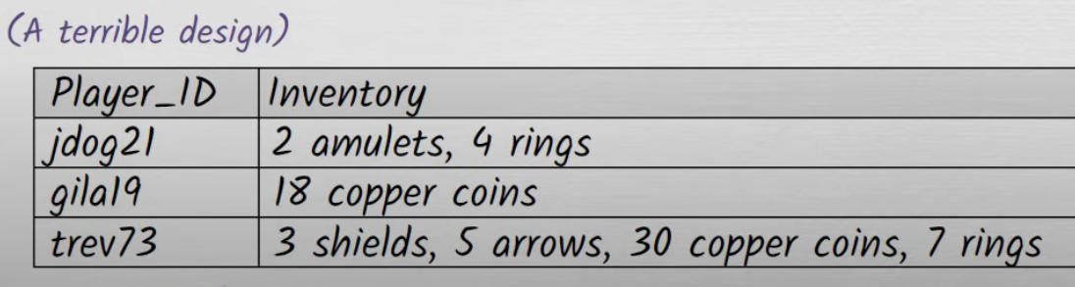
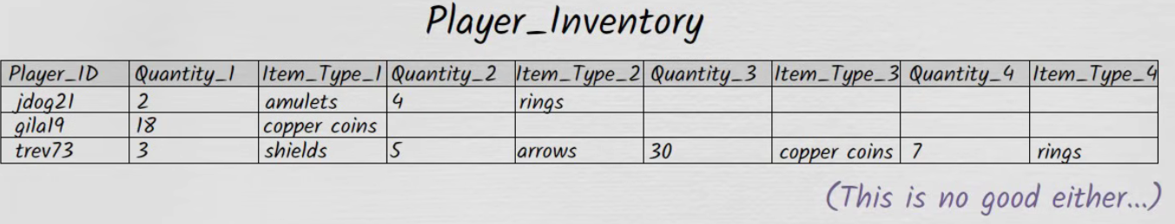
1NF

Slide 19
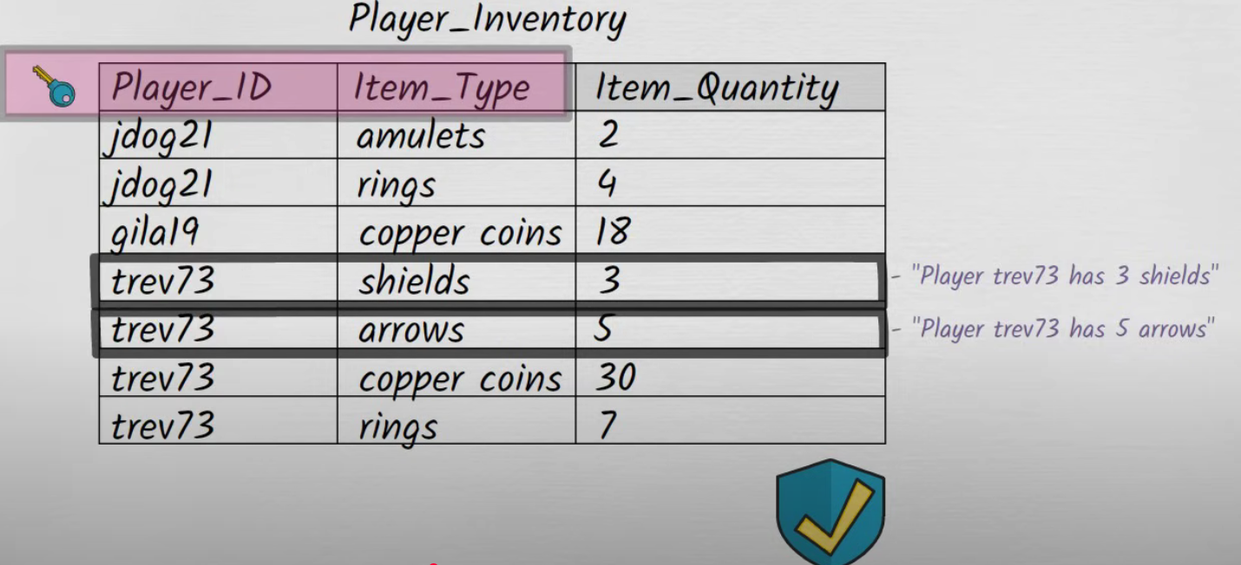
1NF

Slide 20
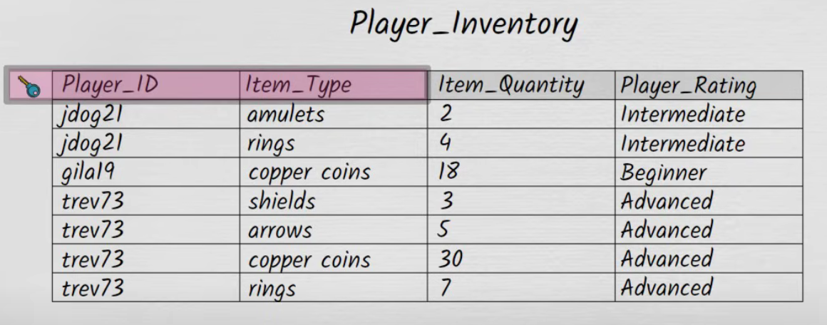
2NF

Slide 21
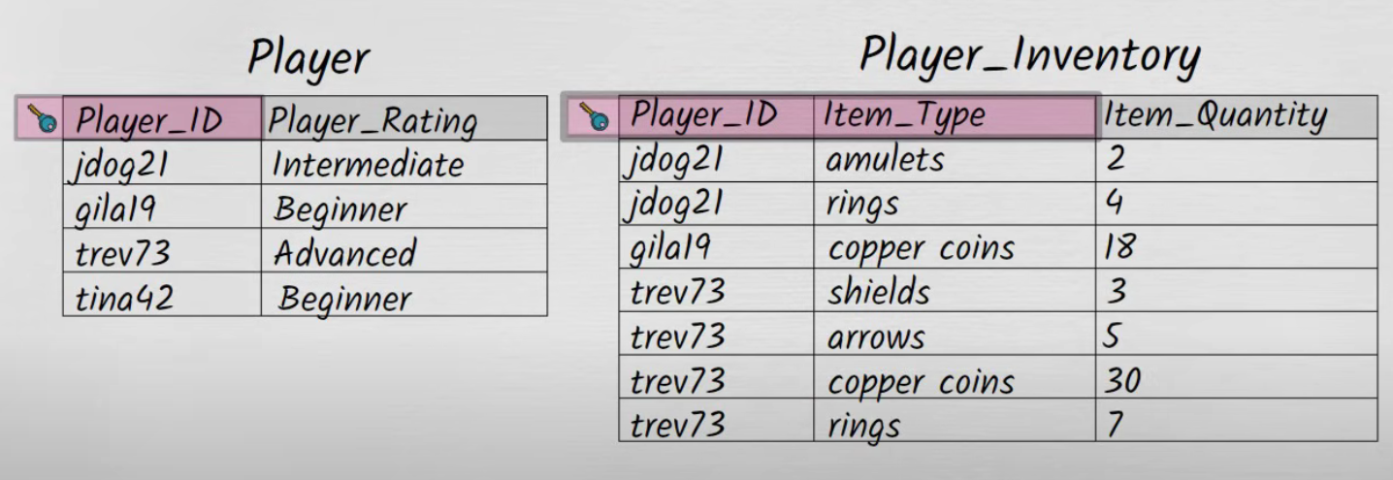
2NF

Slide 22
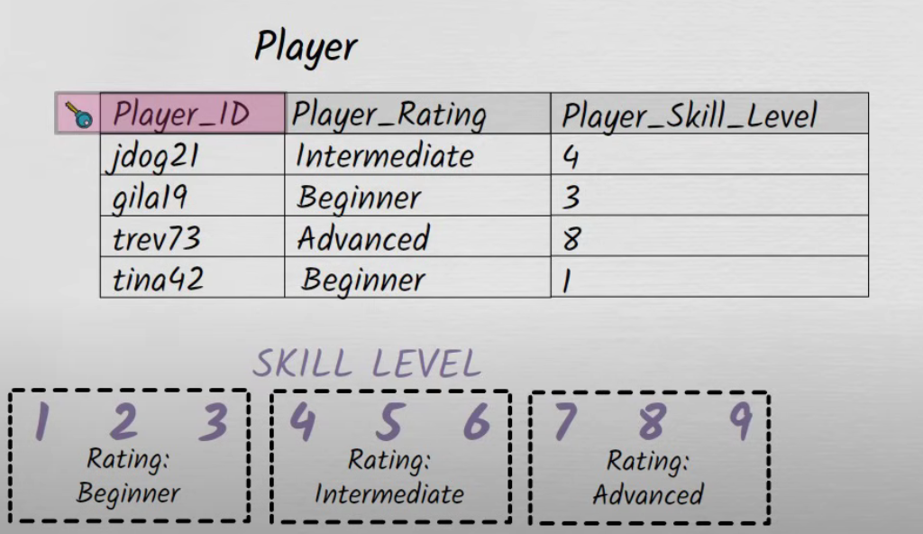
3NF

Slide 23
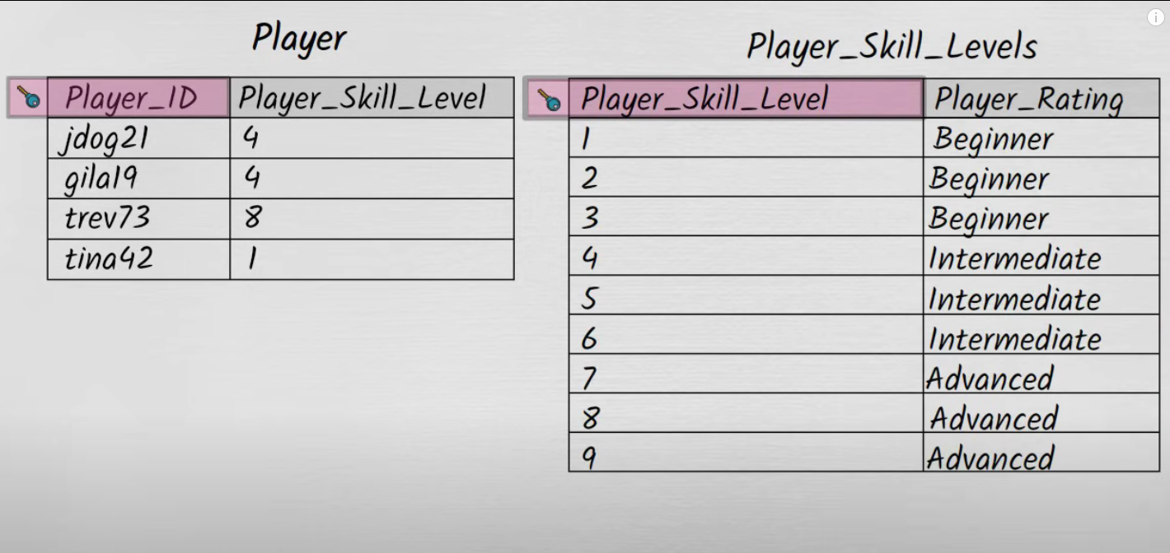
3NF

Slide 24
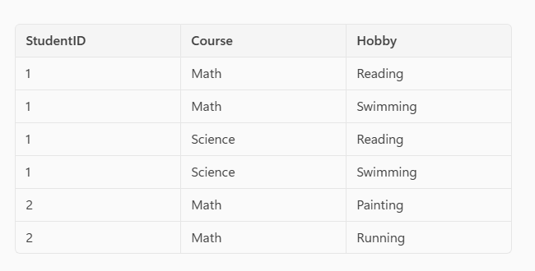
4NF

Slide 25
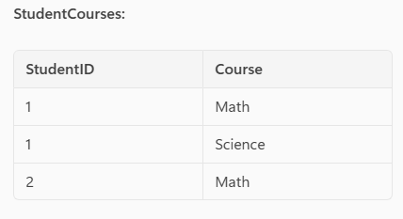
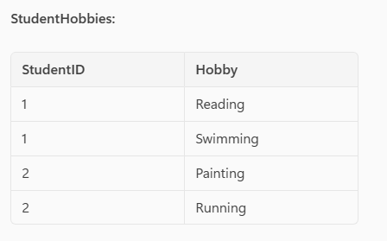
4NF

Slide 26
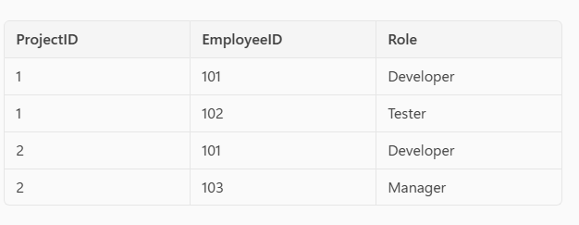
5NF

Slide 27
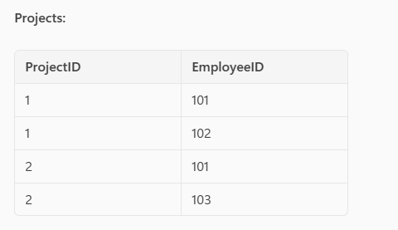
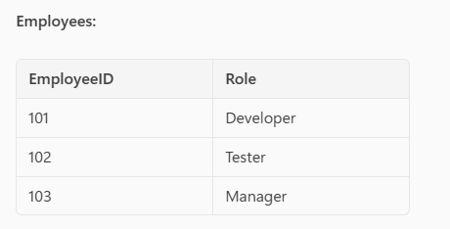
5NF

Slide 28
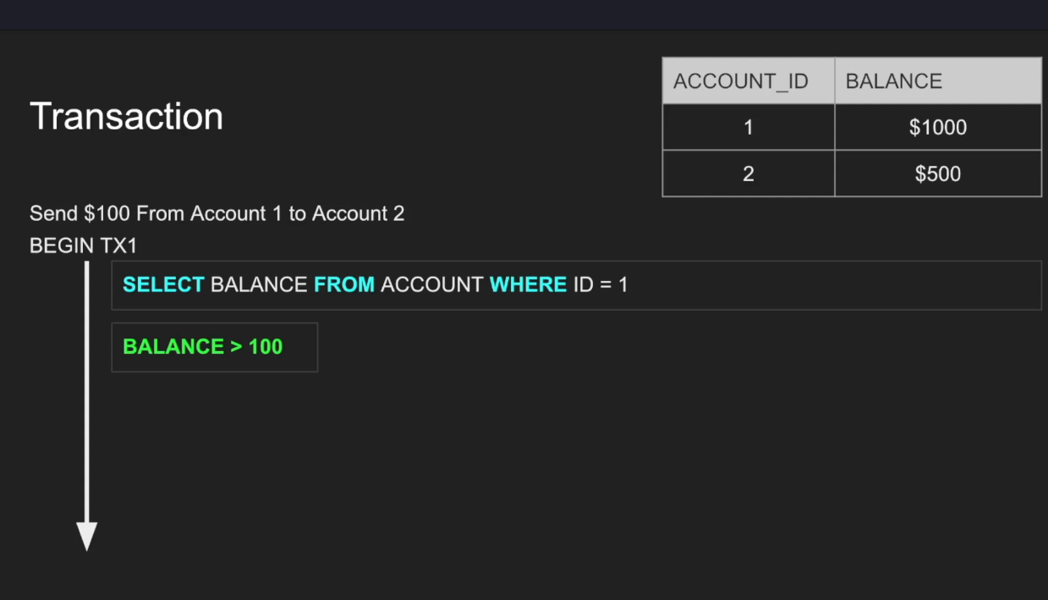
Transactions

Slide 29
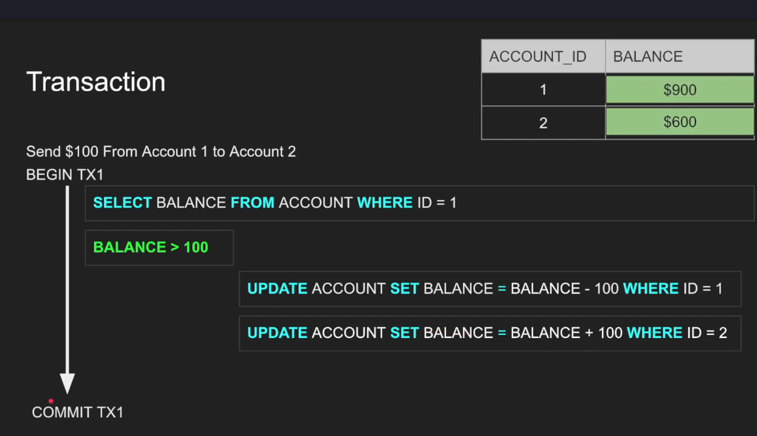
Transactions

Slide 30
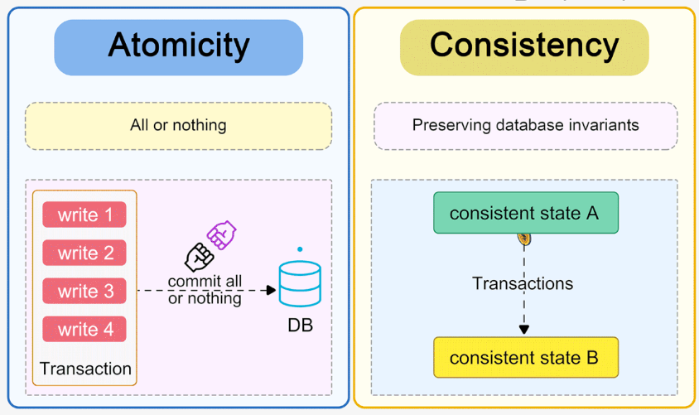

Slide 31
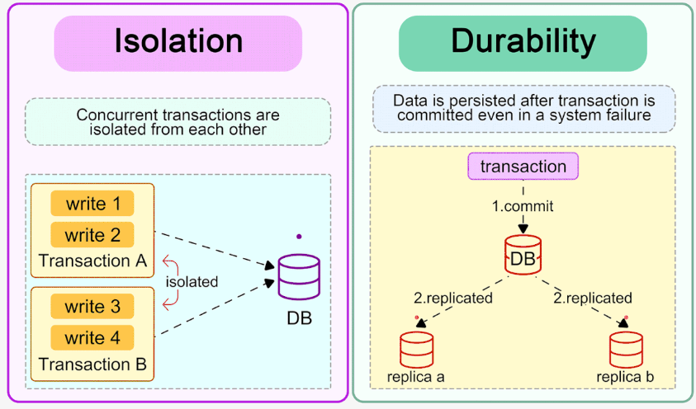

Slide 32

Atomicity

Slide 33
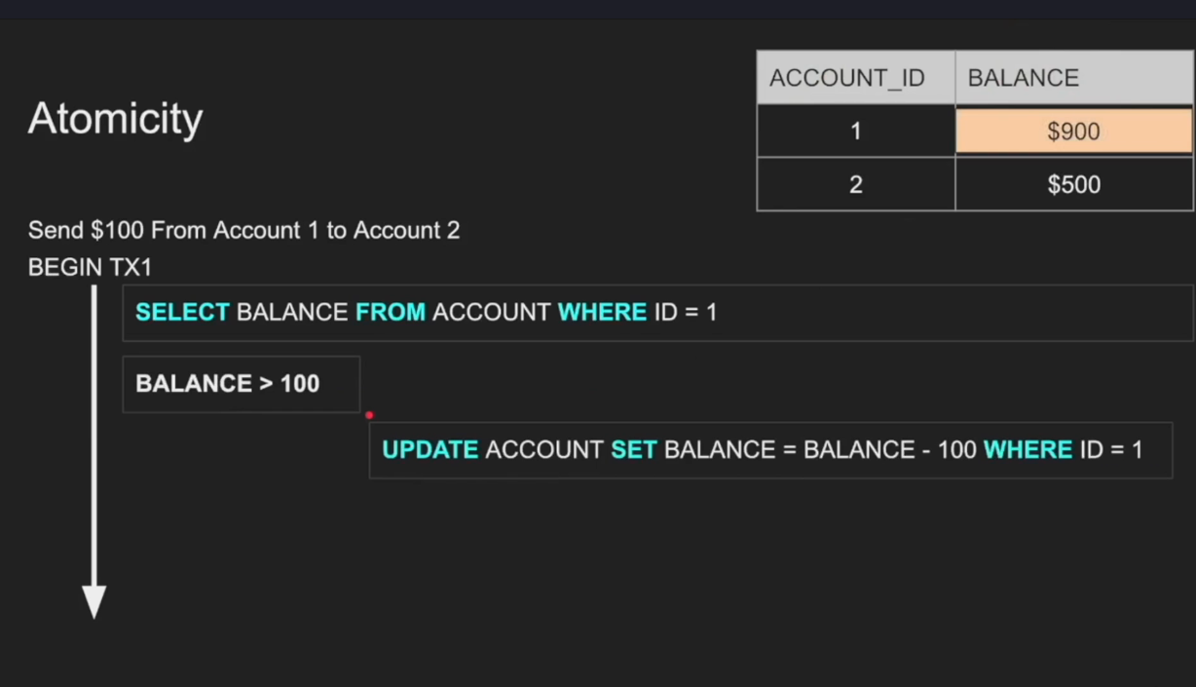
Atomicity

Slide 34
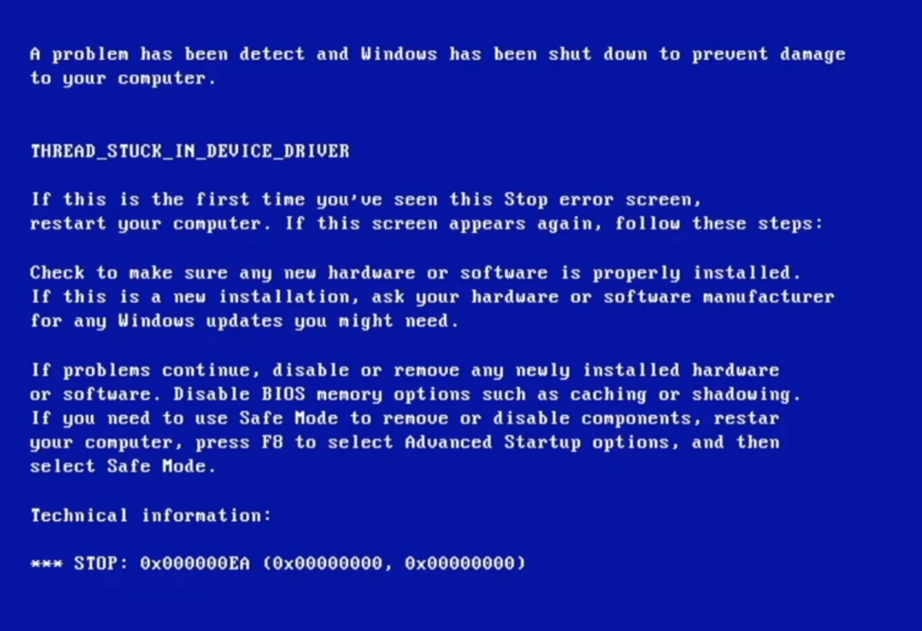
Atomicity

Slide 35
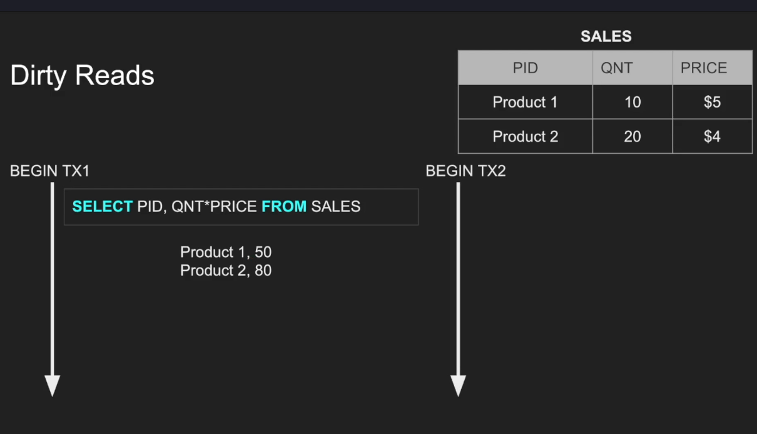

Isolation – Read phenomena

Slide 36
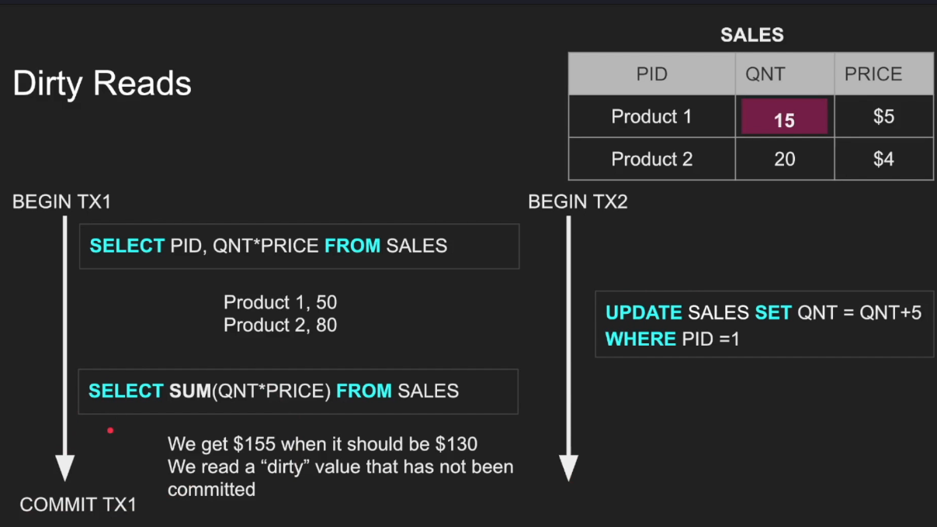
Isolation – Read phenomena

Slide 37
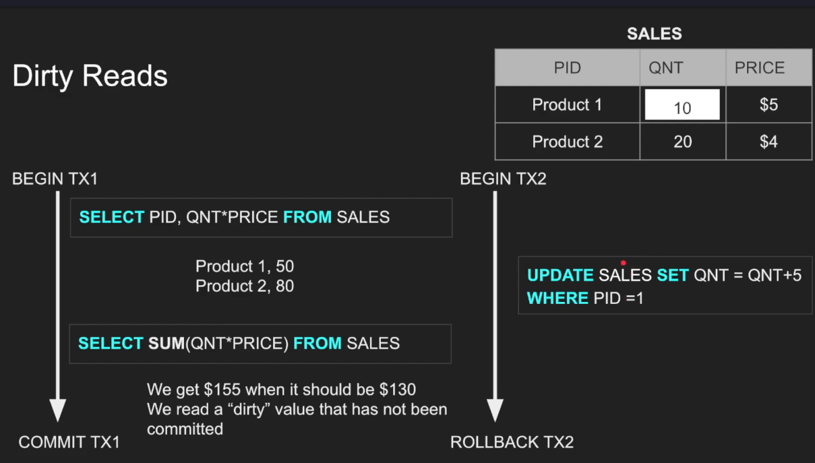
Isolation – Read phenomena

Slide 38
Isolation – Read phenomena

Slide 39
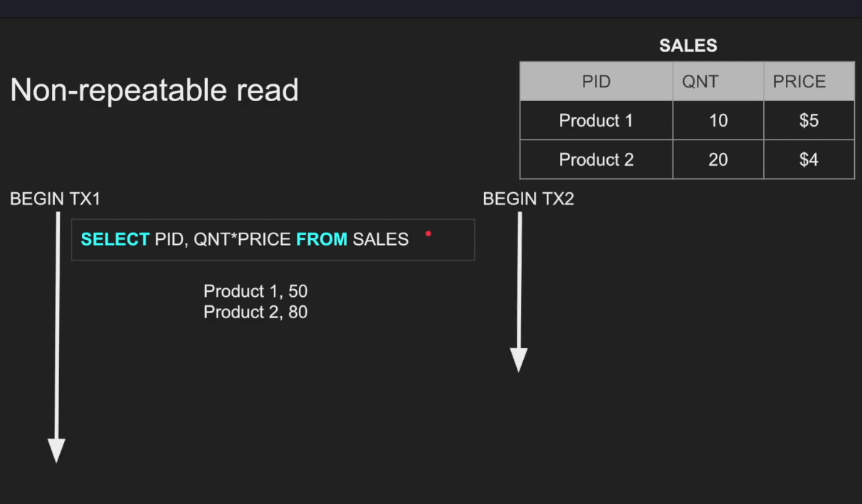
Isolation – Read phenomena

Slide 40
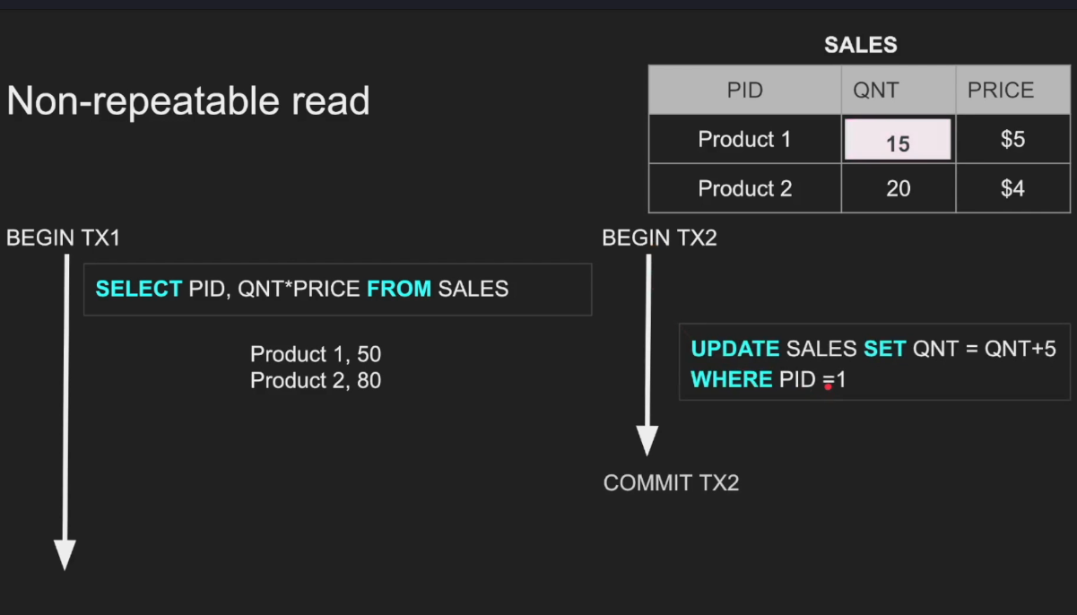
Isolation – Read phenomena

Slide 41
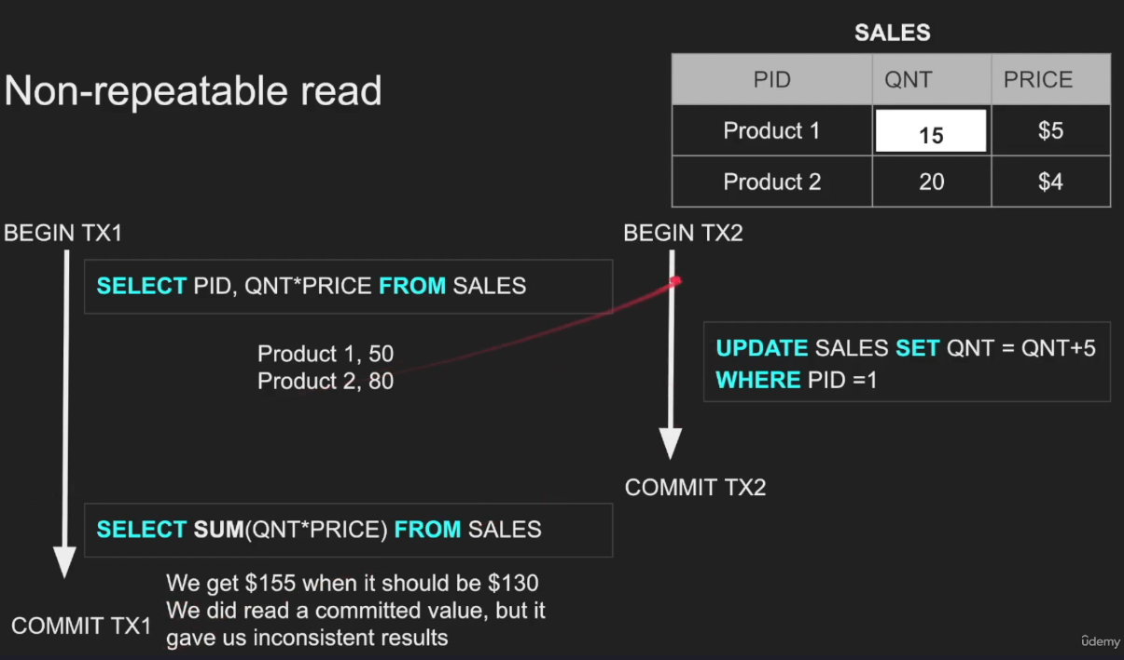
Isolation – Read phenomena

Slide 42
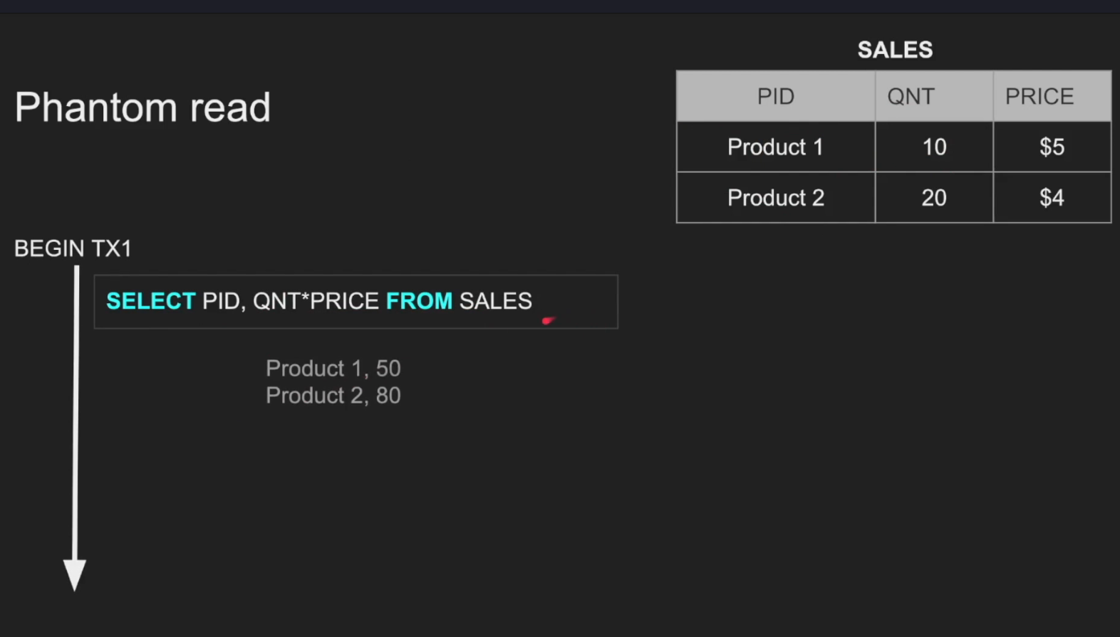
Isolation – Read phenomena

Slide 43
Isolation – Read phenomena

Slide 44
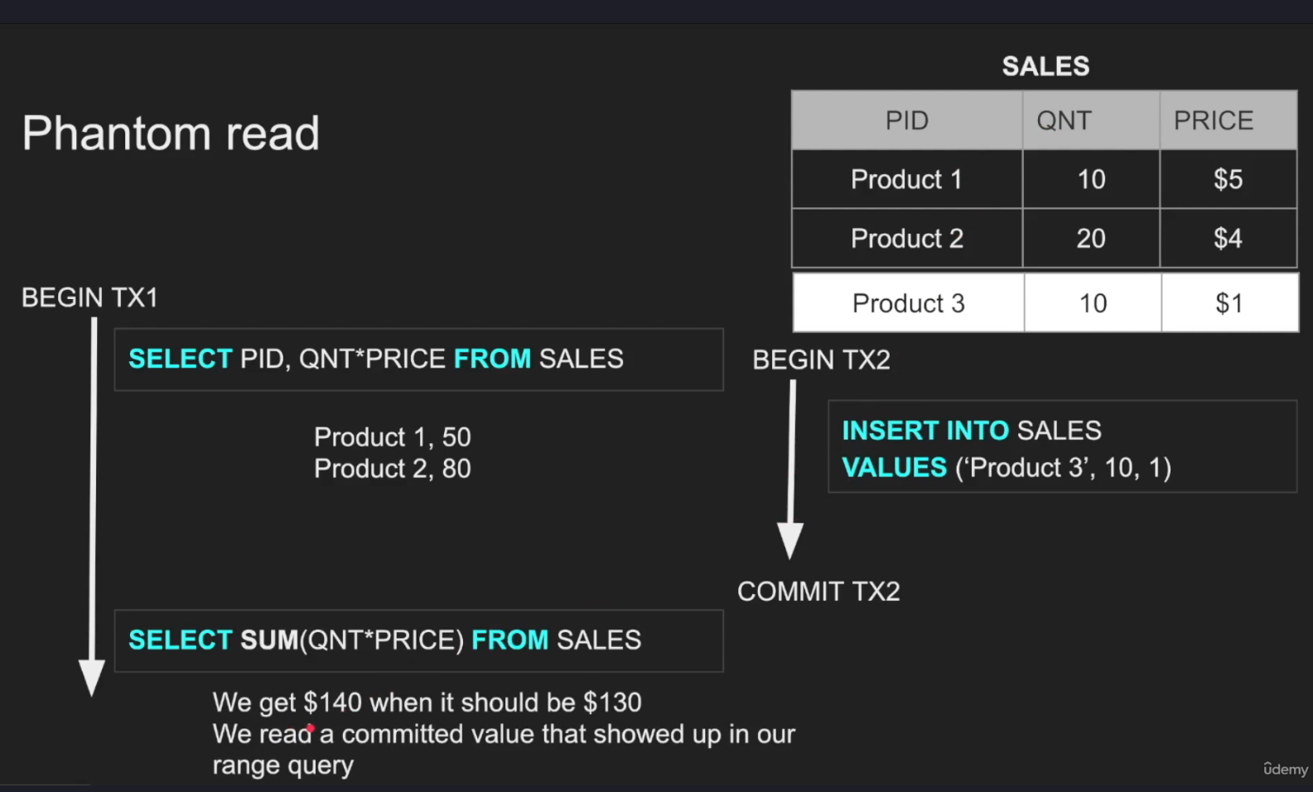
Isolation – Read phenomena

Slide 45
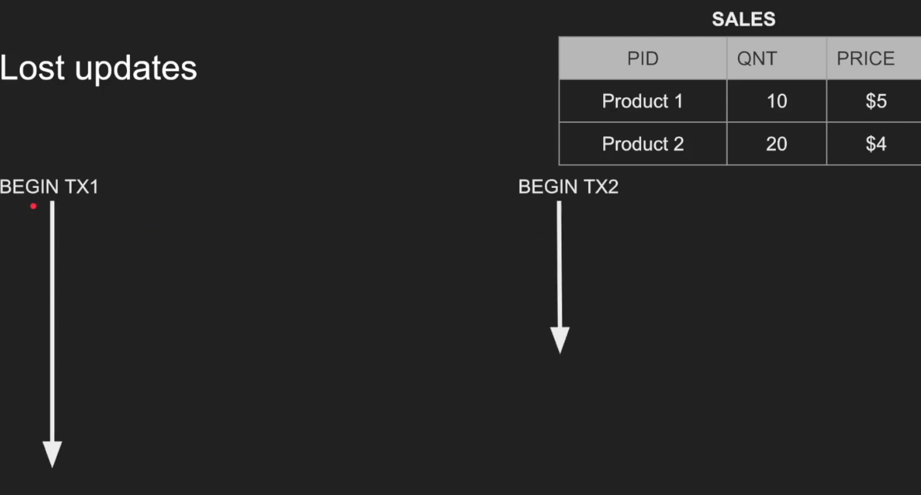
Isolation – Read phenomena

Slide 46
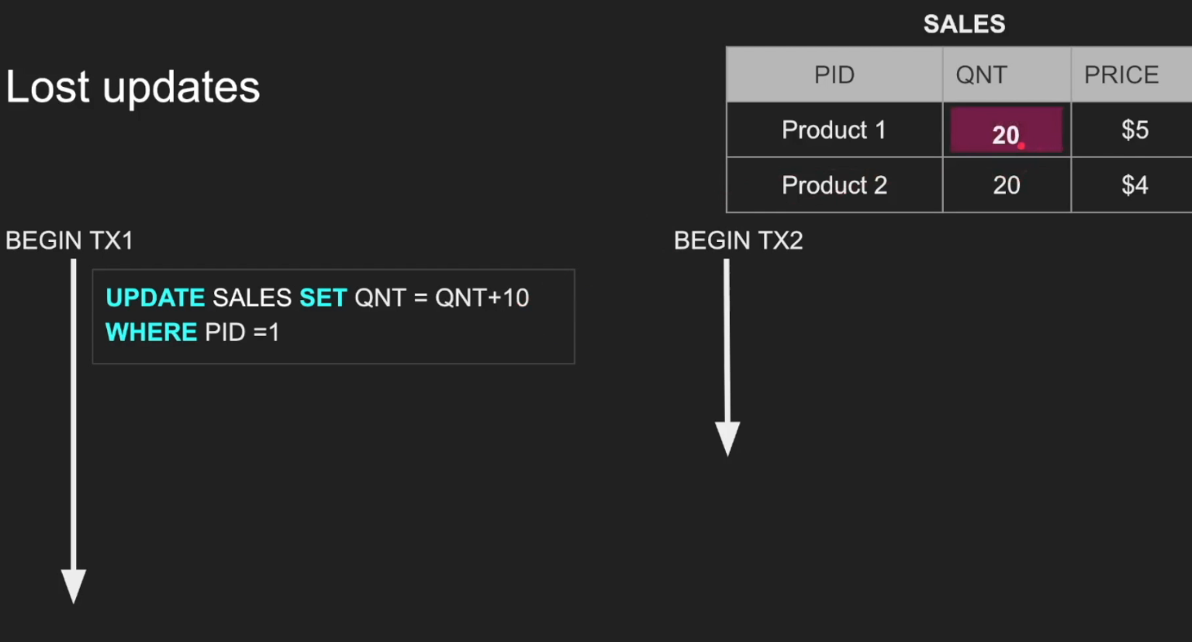
Isolation – Read phenomena

Slide 47
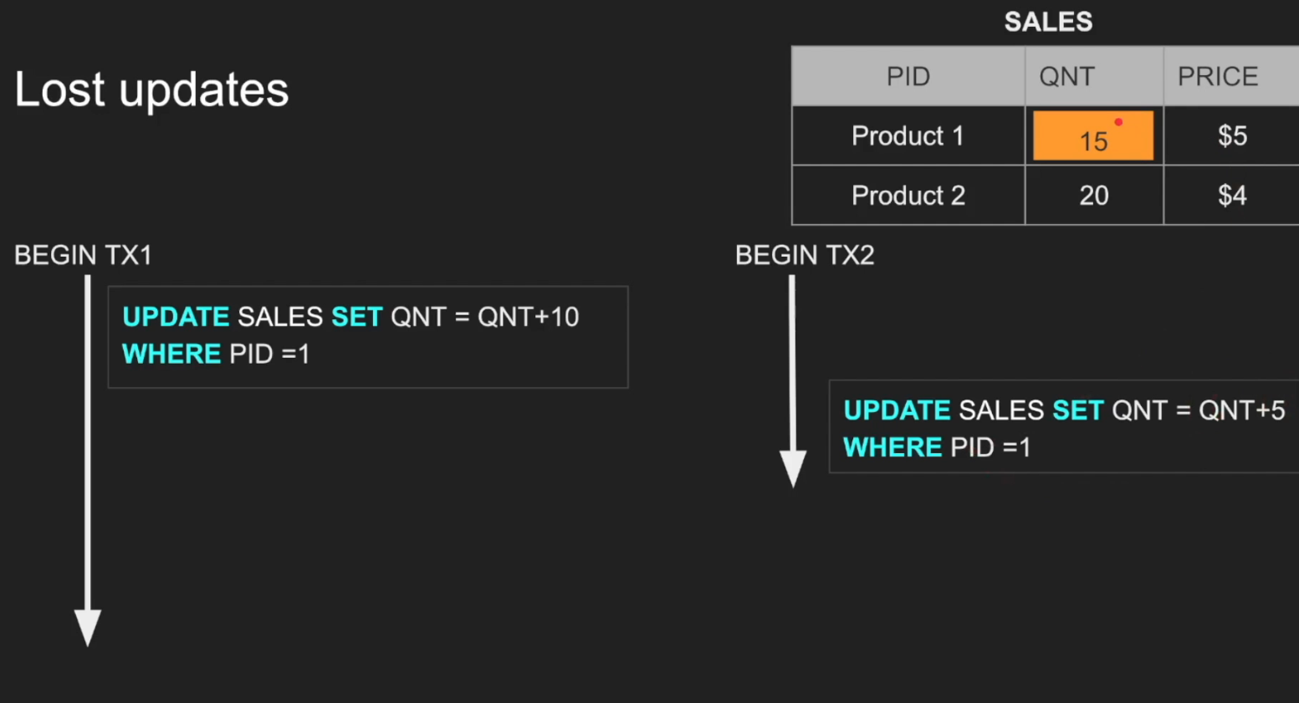
Isolation – Read phenomena

Slide 48
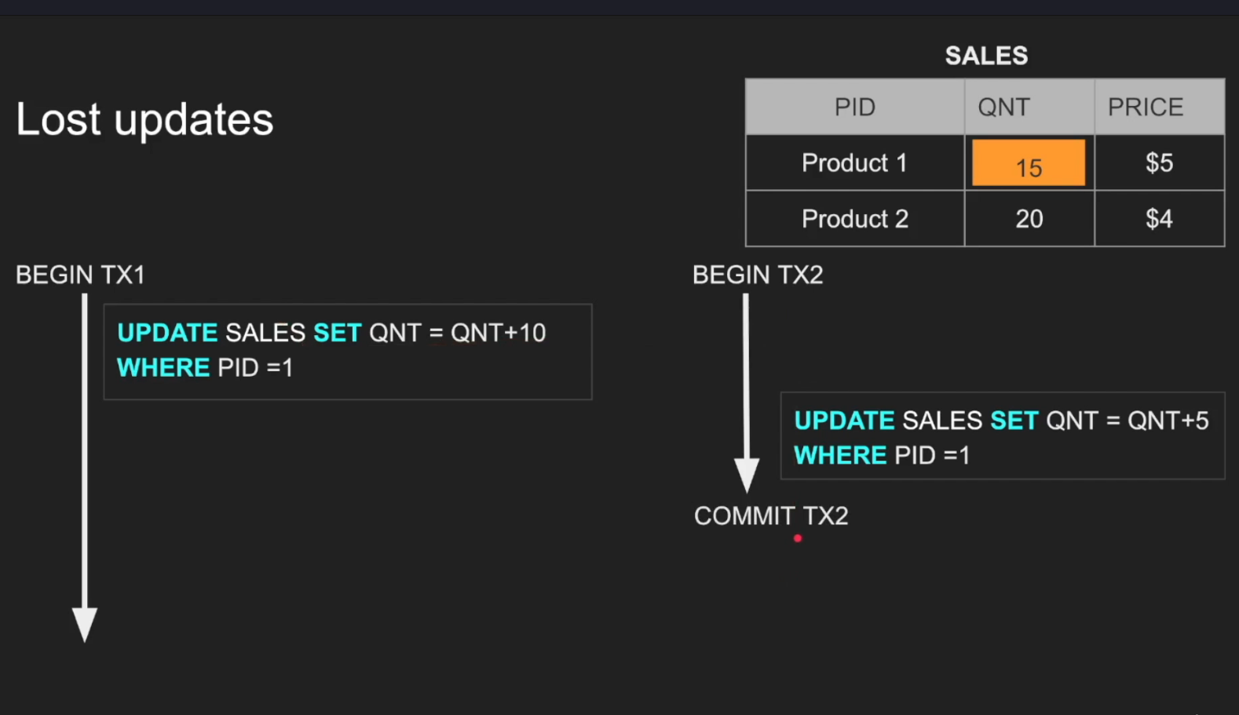
Isolation – Read phenomena

Slide 49
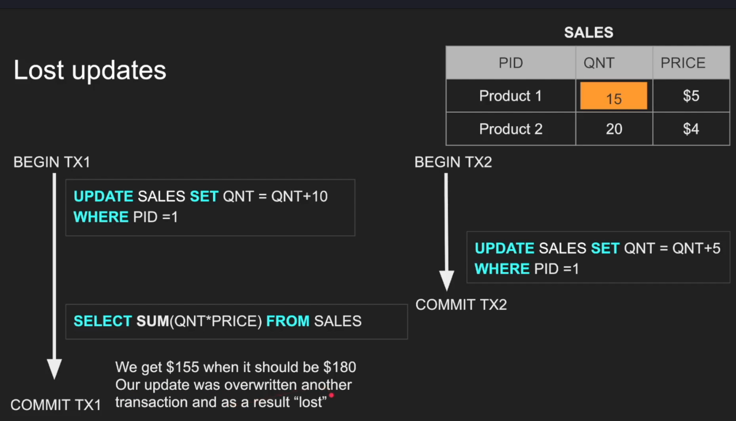
Isolation – Read phenomena

Slide 50
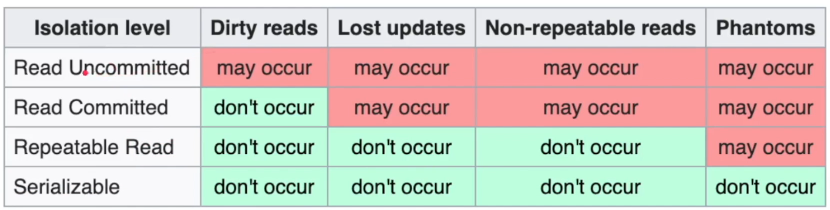
Isolation - Isolation Levels

Slide 51
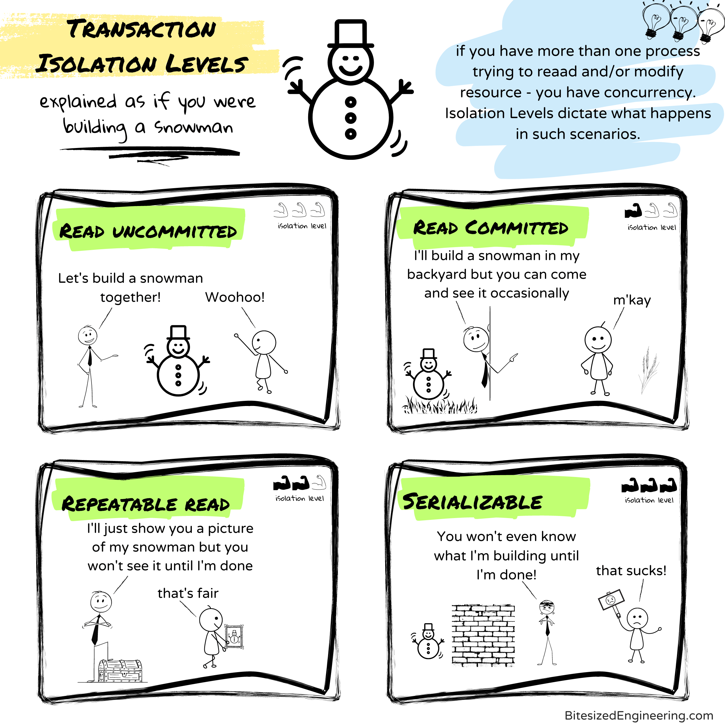
Isolation - Isolation Levels

Slide 52

Consistency
Consistency in DATA
Consistency in READ

Slide 53
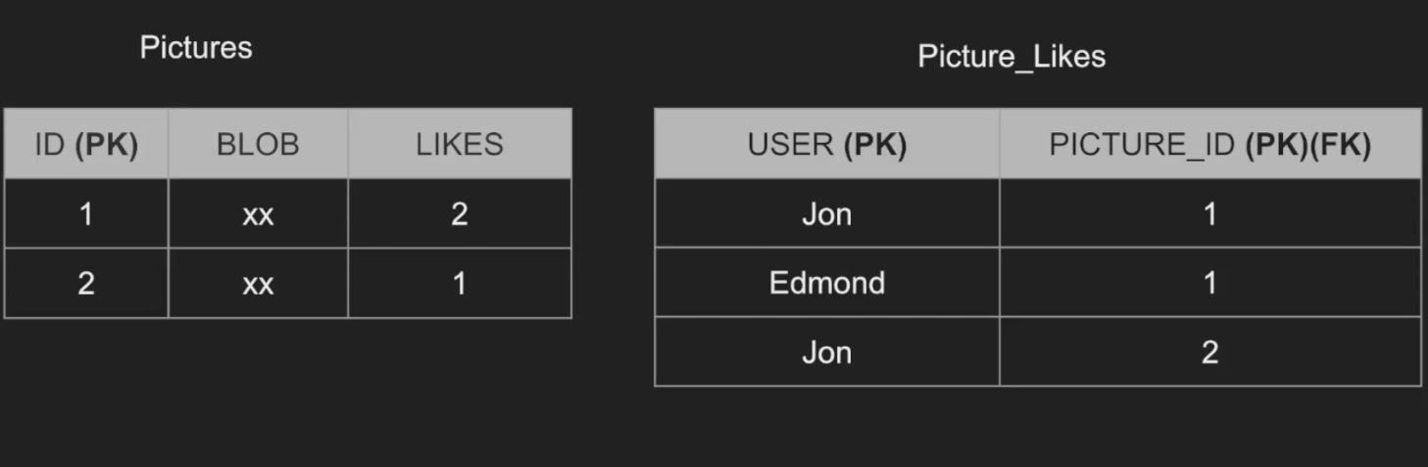
Consistency in DATA

Slide 54
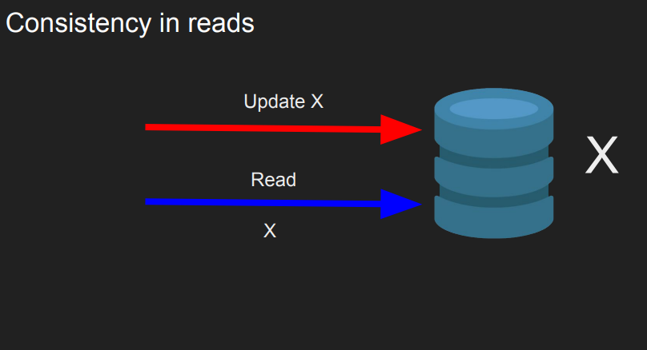
Consistency in READ

Slide 55

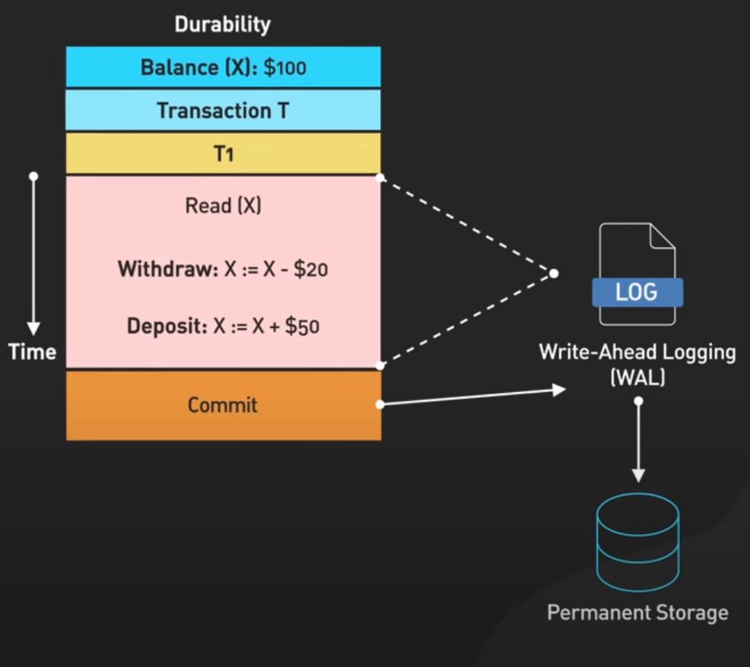
Durability

Slide 56
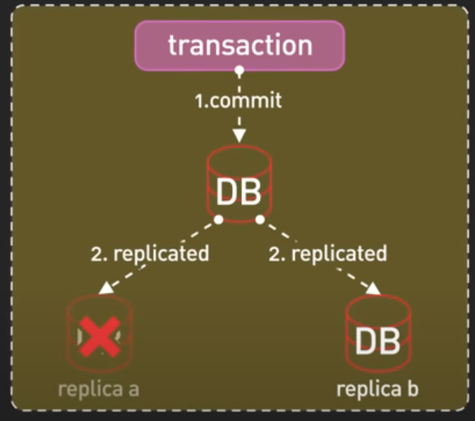
Durability

Slide 57

ACID

Slide 58

SQL Execution Order

Slide 59


Indexing

Slide 60

Indexing

Slide 61

Indexing

Slide 62

Execution Plan

Slide 63

Execution Plan

Slide 64
Partitioning

Slide 65
Sharding

Slide 66
Concurrency Control

Slide 67
Replication

Slide 68
Discusion

Slide 70
Thank you !

